Slide 1
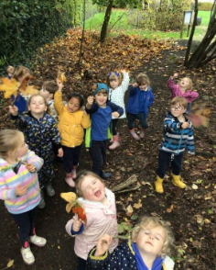
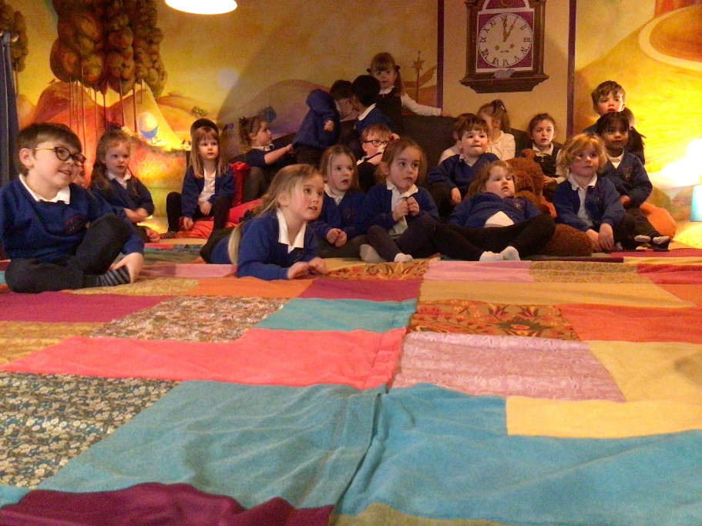
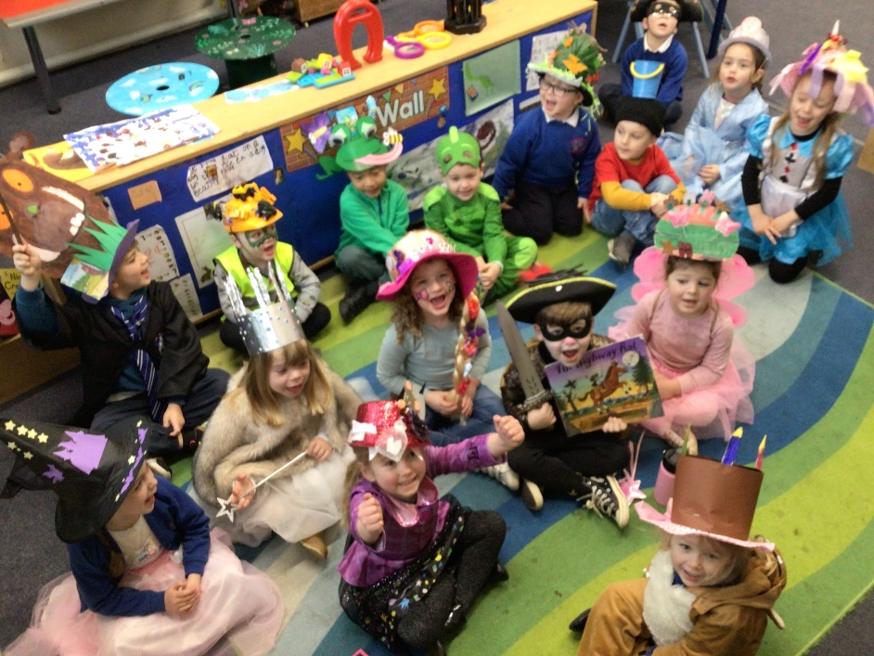
Welcome to Darling Class
Hello, welcome to your new class at Stanton St Quintin School.
We are really looking forward to meeting you. We have lots of fun at school and we know that you will really enjoy being here.
This booklet will show you some of people that you will be with, some of the awesome things that we do and the different areas that we use in the school.

Slide 2
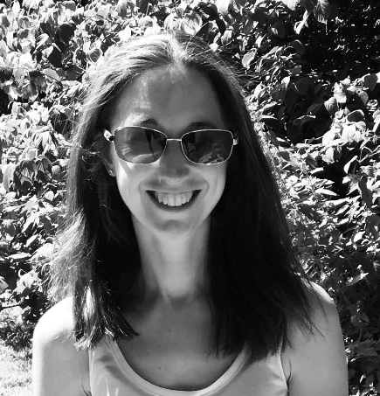
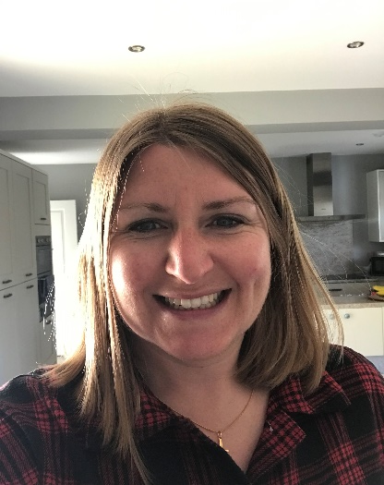
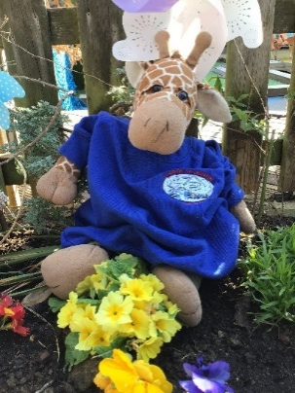
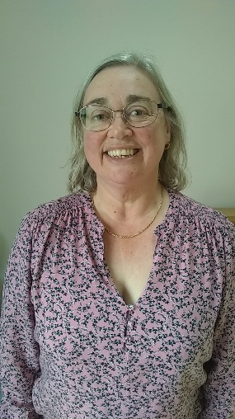
Let’s meet the team
These are the people who work in Darling Class and they are here to help you to settle in, make new friends and be there to support you in your learning and play.
Douglas is our class mascot and he is in Darling Class all the time. “I love hugs and playing with the children in Darling Class.”
Mrs Harwood works in Darling Class on a Monday, Thursday and Friday. “I have been at Stanton just over a year and am doing an ELSA course. I love playing netball.”
Mrs Breen teaches in Darling Class on Mondays, Tuesdays and Wednesdays.
“I love being outdoors and have fun adventures with my family.”
Mrs Hunter teaches in Darling Class on Thursdays and Fridays.
“I enjoy running, playing netball, reading. My favourite thing to do is go to the theatre and watch a musical.”

Slide 3
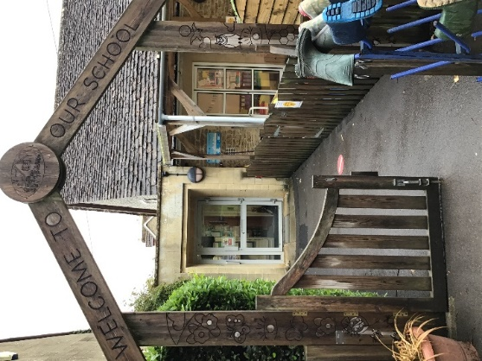
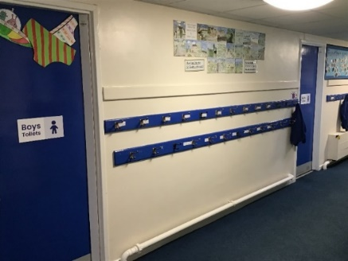
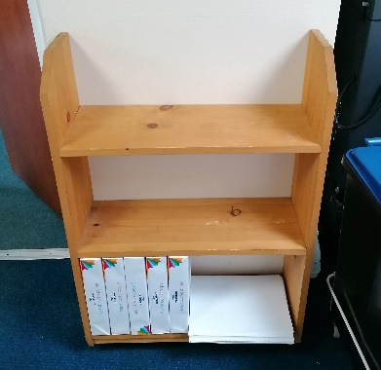
When you arrive
When we arrive we line up with our adult at this little gate.
Your teacher will come and meet you and bring you in to school. This is where you give your adult a big hug and kiss goodbye and tell them not to miss you too much.
When you come into school we will sanitise our hands using the hand sanitiser just inside the front door.
Then you will be able to hang up your coat on your own peg.
If you have a packed lunch, it goes on the shelves opposite the coat pegs.

Slide 4
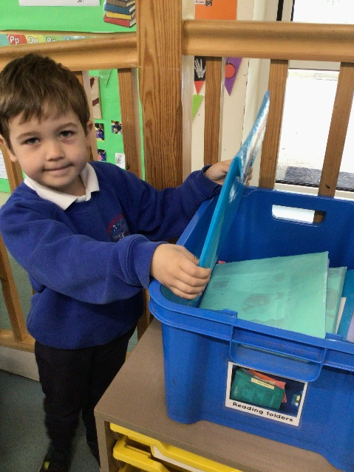
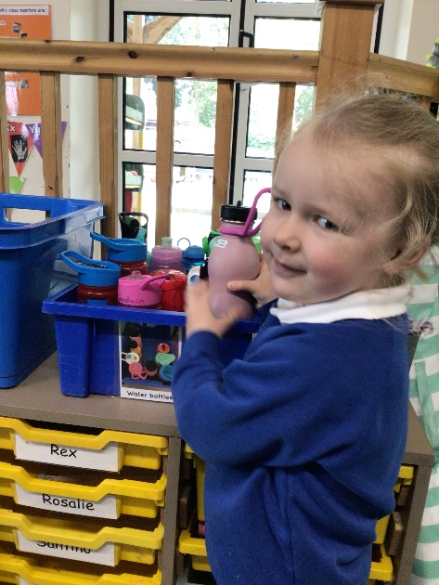
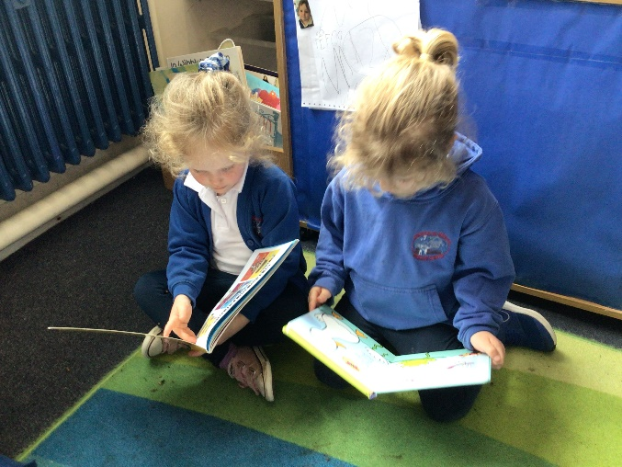
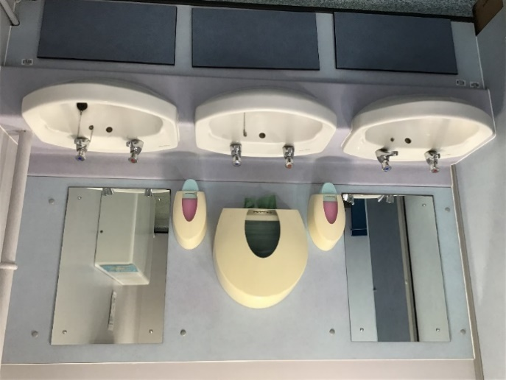
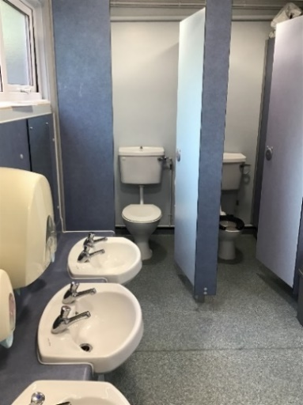
You put your water bottle and reading folder into the boxes inside the classroom.
After doing all of your jobs you can choose a book to look at on the carpet while we wait for the other children to arrive and settle.
Our class toilets are just along the corridor from our classroom, where we hang up our coats.
We must ask an adult before we leave the classroom to go to the toilets.
We make sure that we wash our hands properly afterwards.

Slide 5
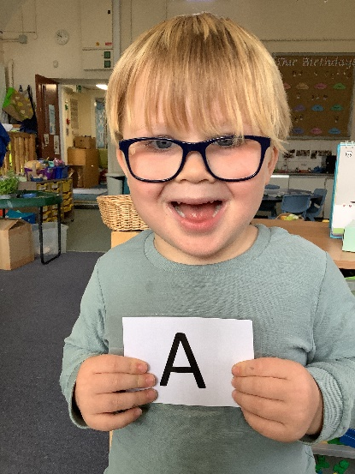
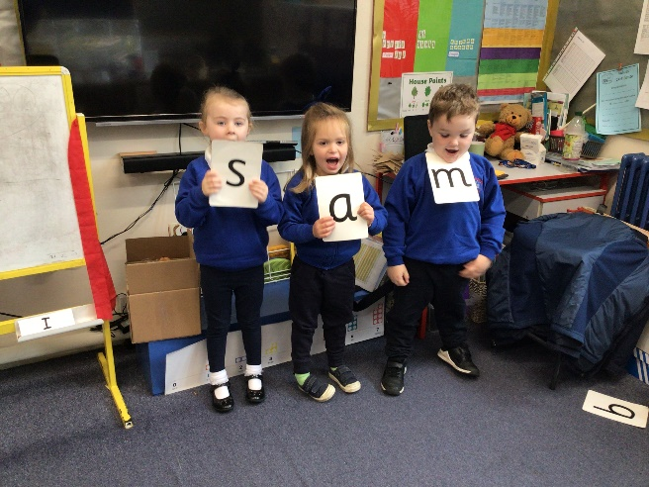
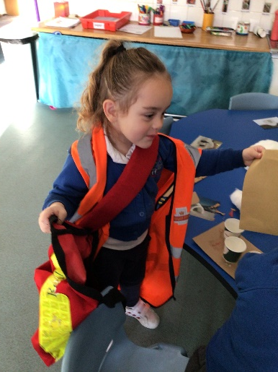
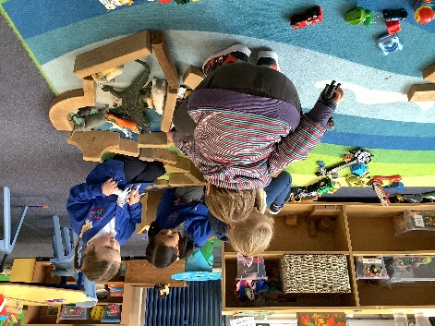
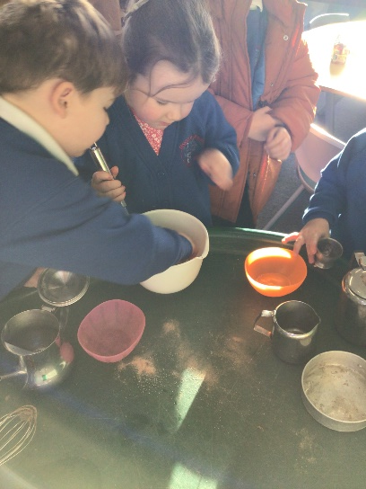
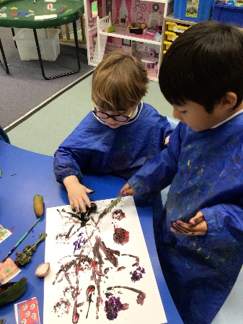
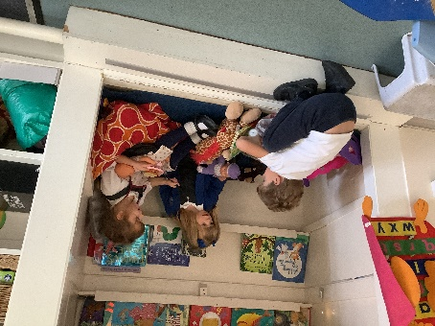
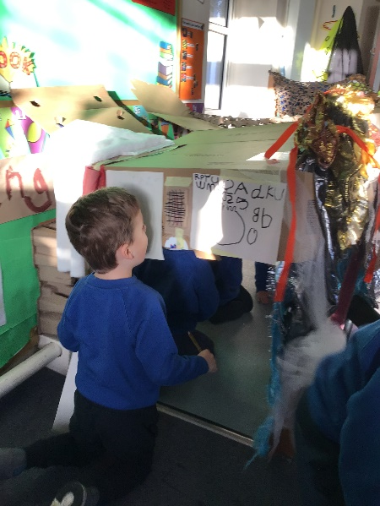
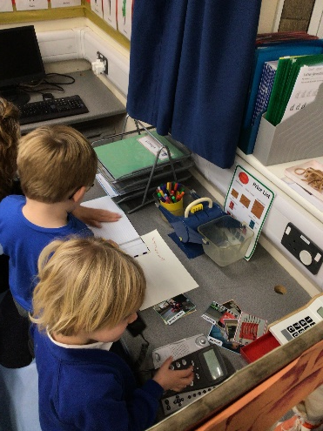
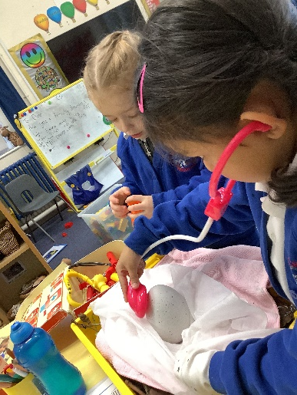
Mornings in Darling Class
In the mornings, we begin with our phonics. We sit on the carpet to learn our lesson sounds and do fun word building activities to help us to learn to read and write.
After phonics we are able to choose. We can choose to stay inside or go outside. There is always an abundance of exciting activities to choose from.
Here are some of the areas that you might
enjoy visiting inside…

Slide 6
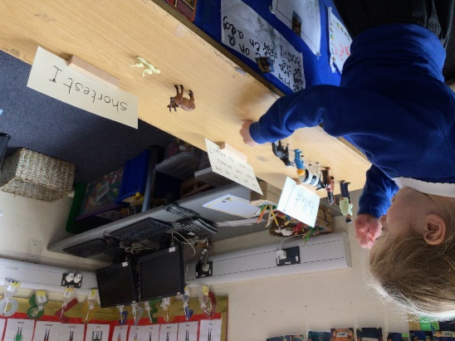
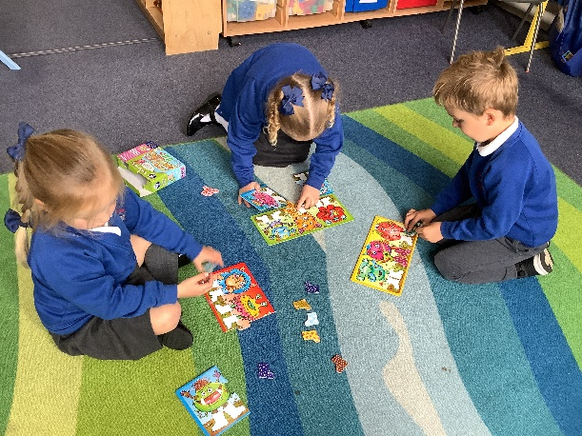
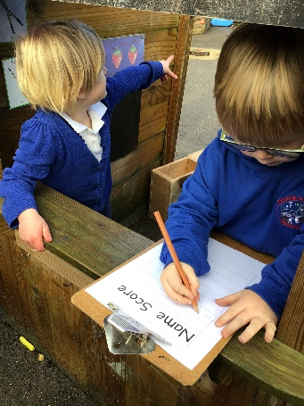
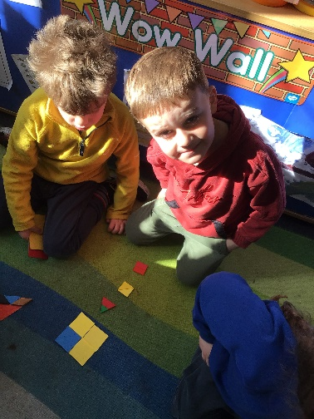
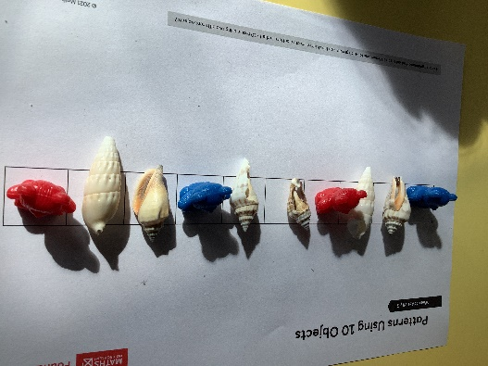
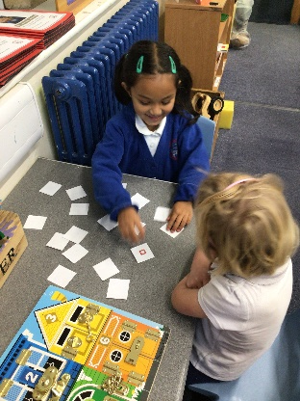
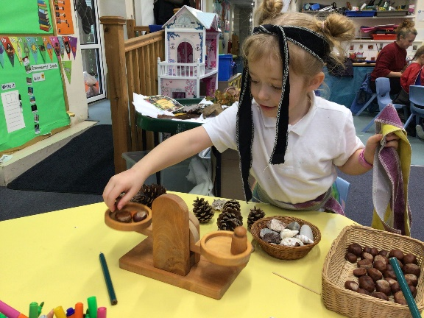
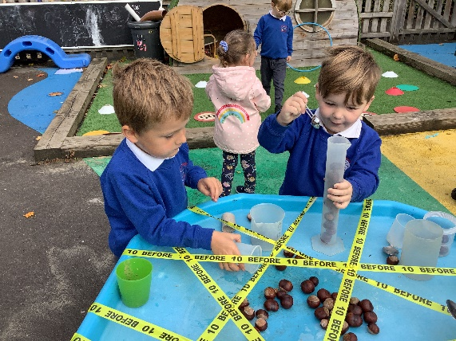
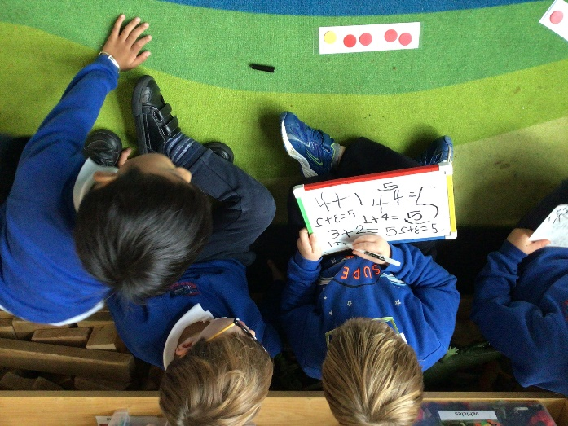
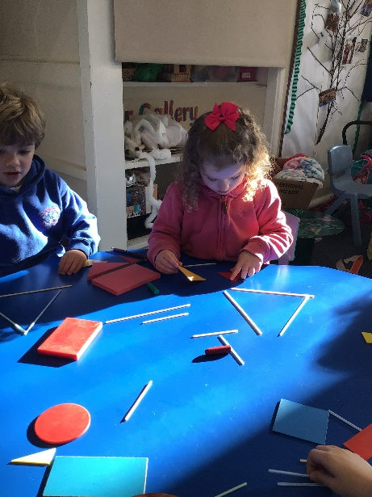
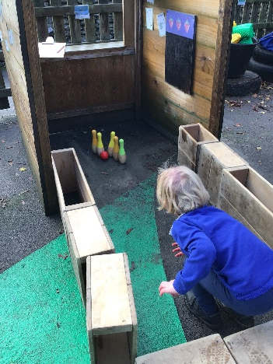
Later on, we will come to the carpet together for Maths. We love our maths to be fun and interactive and it never matters if we don’t get a right answer because we are learning by having a go and that is celebrated here.

Slide 7
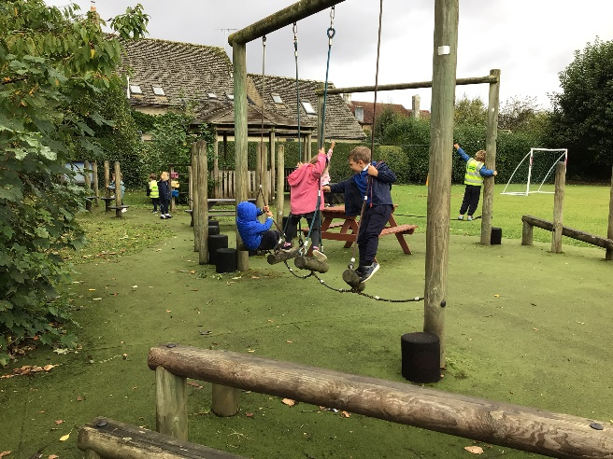
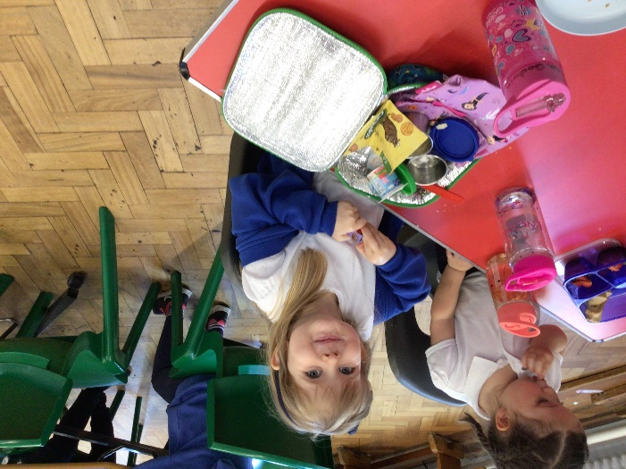
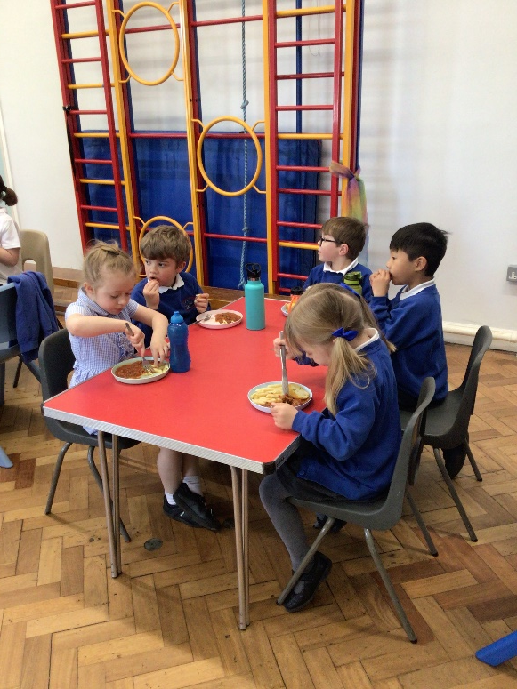
Lunchtimes at school
We have our lunch at 12 o’clock. We get ready by going to the toilet and washing our hands and then we line up with our water bottle. We sit at tables with our friends and eat either a hot dinner or a packed lunch. The lunches at school are very yummy!
After lunch we go outside into the big playground to play. It is great to spend time with our friends in other classes and our buddies too!

Slide 8
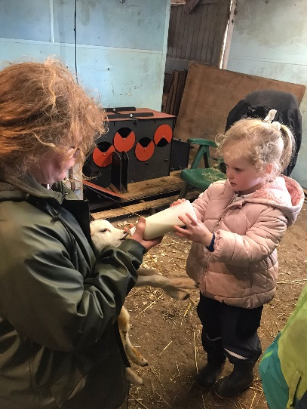
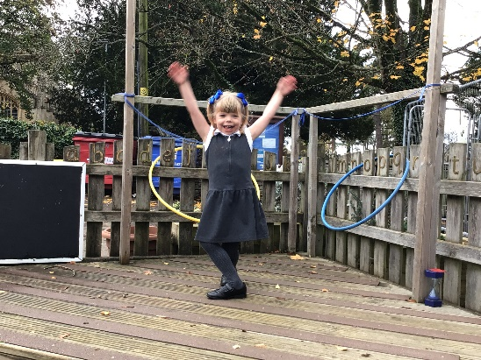
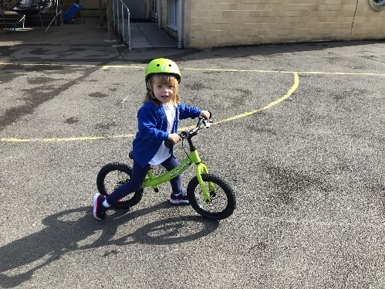
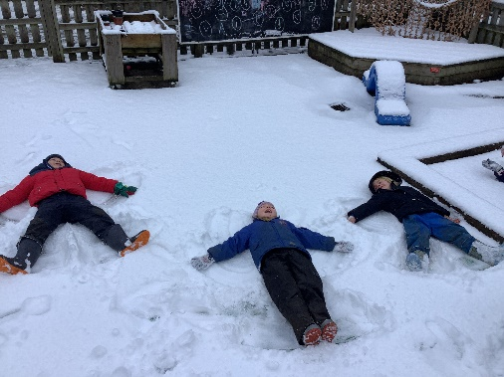
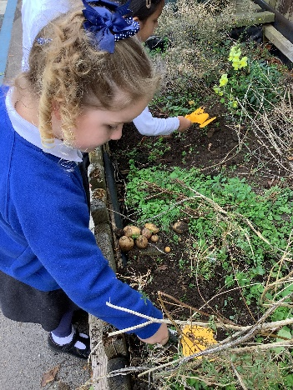
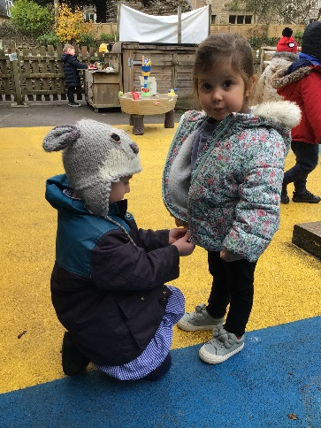
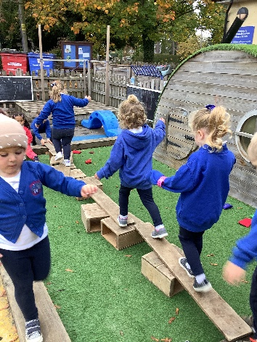
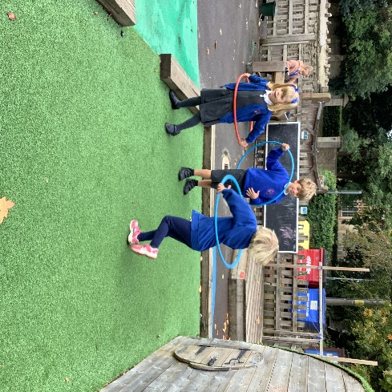
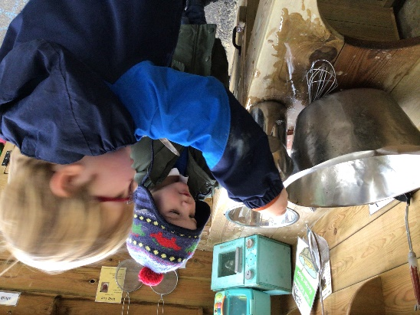
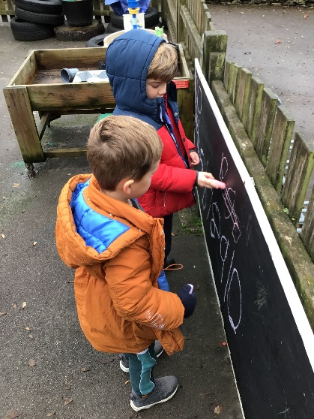
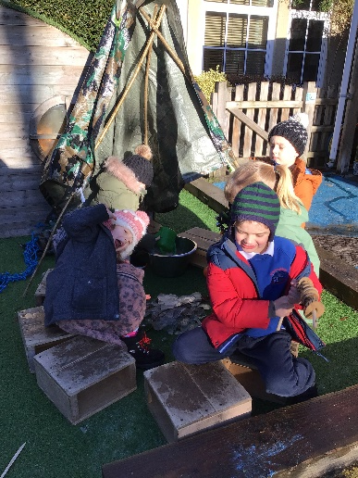

Afternoons in Darling Class
After we have checked that everyone is here we have a carpet session. This might be sharing and talking about a story, learning about places around the world, talking to each other about things we have been doing, observing, exploring and investigating.
After our carpet session we can choose what we would like to do, either inside or outside. Here are some of the areas you might like to visit outside…

Slide 9











Forest School
Once or twice a week we spend the afternoon in the woods, which we love, as it gives us the opportunity to explore the world around us, care for and nurture our environment, challenge ourselves to take risks and have fun with our friends.
To get ready for the woods we visit the toilet and then put on our waterproof clothes. We make sure that we have suitable clothes for the weather so that we don’t get too hot or too cold. We line up at the outside door to our classroom and we are passed our wellies to put on. Then we line up ready to go! These are pictures of some of the things we have had fun doing this year…

Slide 10



Buddies
We each have a buddy from Rhine Class. These people are very special because they look out for us in the playground and we do all sorts of exciting things together during the year…
Hometime
After a wonderful day it is then time to get ready for home time. We collect our coats and then sit on the carpet to share a story or sing some songs. The teacher will call your name when they see someone who is here to collect you. Then it is time to go home and rest all ready for the next day!

