Slide 1

Phonics Screening Check
Week Beginning Monday 9th June
What is the Phonics Screening Check?
What does it looks like?
Key Information
Resources to help your child

Slide 2
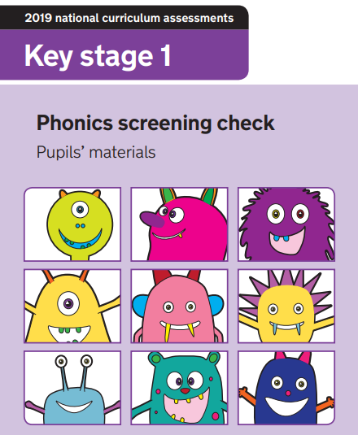
What is the Phonics Screening Check?
The government introduced this check to allow teachers to assess children’s developing phonic knowledge. It is a test administered to Year 1 children nationally.
It is an assessment where children are given 40 words to read correctly to the teacher. It is 1:1 assessment that they do in a quiet environment.
In this test, children will recognise and identify sounds that individual letters and combinations of letters make, and blend these sounds together from left to right to make a word.
This is to ensure that can children can use this knowledge to segment and blend new words that they hear or see as they get older.
Children need to read 32 or more words correctly to pass the Phonics Screening Check. This has been the standard score required in the previous checks, but it could be subject to change every year.
It is not a timed activity, unlike Year 6 SATS. Children need time to carefully read words. It usually takes 5 minutes. For children who need a break half way through, this will be given.

Slide 3

What is the Phonics Screening Check?
Example of segmenting and blending.
In this example, children should be able to identify the individual phonemes that make up the words by;
Looking at the word first to identify any known graphemes (the way we write a sound).
Segmenting the word into individual sounds out loud.
Blending the individual sounds to form a word.
Then checking the word to see if it makes sense.
Example taken from the 2022 Phonics Screening Check, page 19.
At this point in the year, children have been taught all the split-digraphs, digraphs, trigraphs and graphemes needed for the Phonics Screening Check.
Children can segment and sound-talk and blend it in their head. Children can use their finger to point to any graphemes they can spot. Some children can read words instantly.

Slide 4
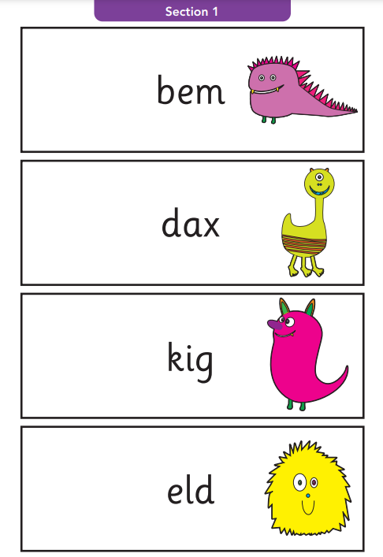
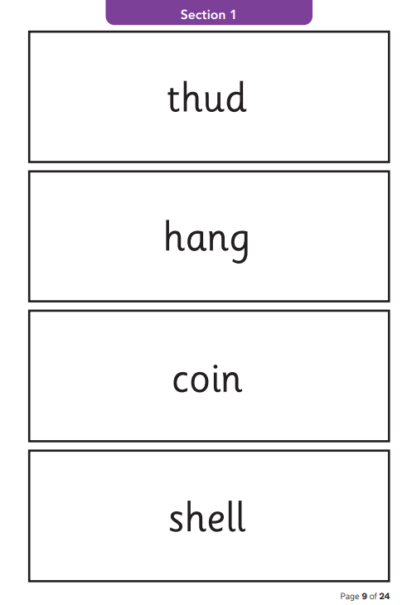
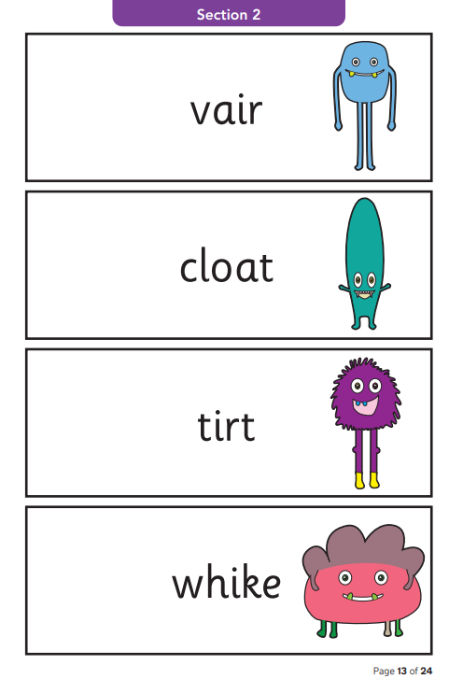
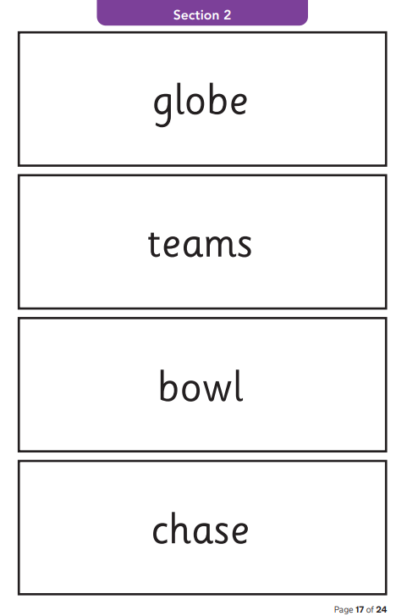
What does it look like?
To a child
Section 1
12 ‘nonsense’ words.
8 real words.
+
Single letters (a, b, c, d, e, f, g, h, I, j, k, l, m, n, o, p, q(u), r, s, t, u, v, w, x, y, z)
Some consonant digraphs (ch, ck, ff, ll, ng, sh, ss, th, zz)
Frequent and consistent vowel digraphs (ar, ee, oi, oo, or)
Section 2
8 ‘nonsense’ words.
12 real words.
+
Less frequent and consistent vowel digraphs, including split digraphs (a-e, ai, au, aw, ay, ea, e-e, er, ew, i-e, ie, ir, oa, o-e, ou, ow, oy, ue, u-e, ur)
Trigraphs (air, igh).

Slide 5

Nonsense Words
All ‘nonsense’ words will be accompanied by a picture of an imaginary creature. This is so it lets the children know it is not a real word and so the children know not to turn the word into a real word. (e.g. meat, meats, yeast, east)
These words are included in the check specifically to assess whether you child can decode a word using phonic skills and not their memory. They need to be able to read and decode words that are unfamiliar to them.
When children experience new words for the first time in their reading books, they have to use their decoding and blending skills to identify the word through their known phonics knowledge. The Phonics Screening Check checks to see if they can do this with good accuracy.
In some examples of the nonsense words, digraphs can have alternative pronunciations. With this word, children may get the mark for either answer;
weaf or weaf.
This is only in the case of a few words!

Slide 6

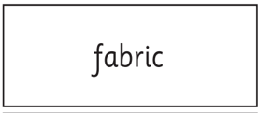
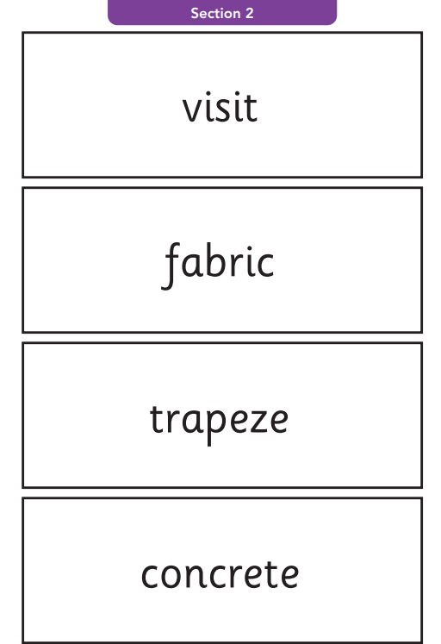

Challenging Words
Section 2 contains complex words, words containing split digraphs and digraphs that are generally harder to learn or are unusual.
Example taken from the 2022 Phonics Screening Check, page 21.
There will be some words that have multiple phonemes in the word. Children can use their fingers and hands to help segment the word and break the word into easier sections, specifically identifying phonemes that they can see in the word.
Some words may have split digraphs. (See examples to the left).
Some words may look like they have a split digraph. Children may see a split digraph and segment and blend the word and if it doesn’t make sense, children can attempt to try and blend it again.
The assessor is unable to tell the child if they are right or wrong. The assessor cannot help them.
“mode – ern” (That is not a real word)
“m-o-d-er-n” (That is a real word)

Slide 7
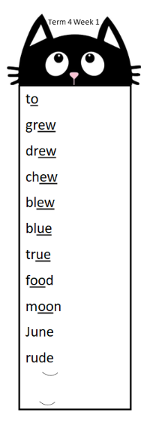
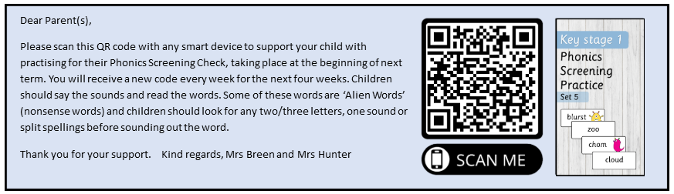
Resources/Tips to help your child
Alongside the Bookmarks, we will be administering a QR code that can be scanned using a SMART device. These have got a sample of real and nonsense words for children to practise.

Slide 8
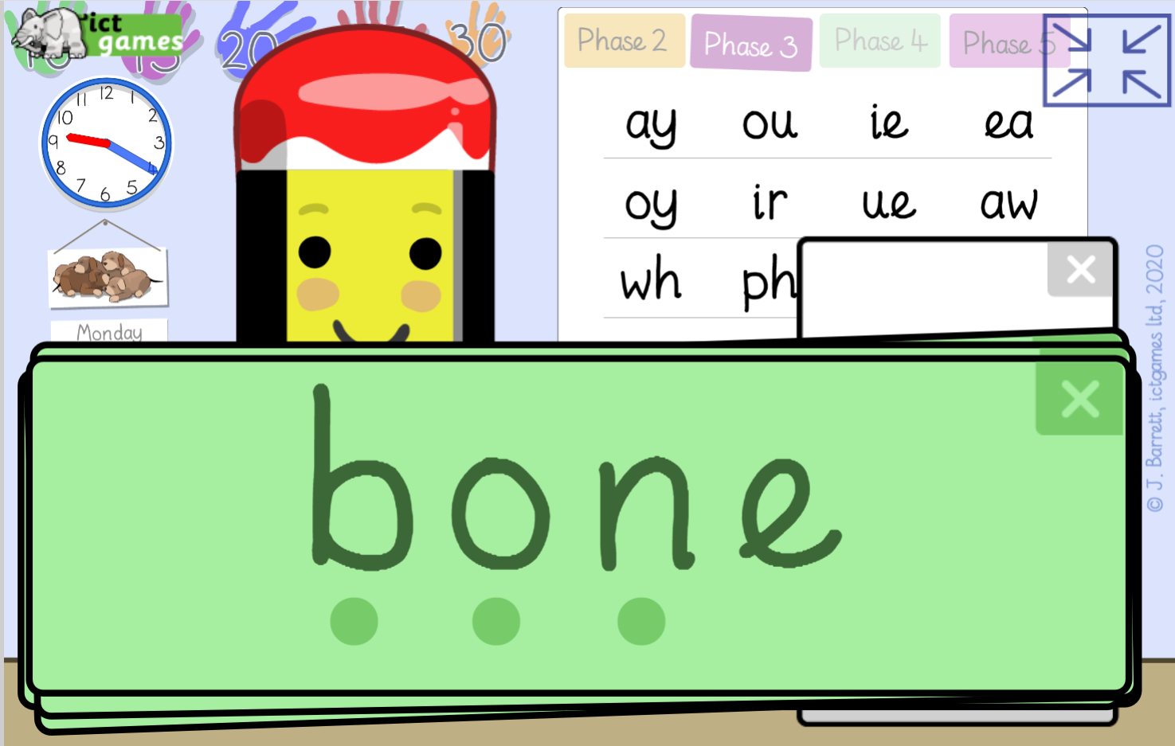
Games! Additional ways to practise phonics
This game has ready-made words for each of the graphemes taught in Year 1.
Bear in mind, that in the actual PSC there will be no sound buttons underneath the but we don’t use sound buttons in the teaching of phonics so these can be ignored.
You can find other Phonics games on Top Marks as well;
https://www.topmarks.co.uk/english-games/5-7-years/letters-and-sounds
https://www.ictgames.com/mobilePage/soundSayer/

Slide 9
Questions
Thank you so much for your time. If you have any questions then please just ask.
All of today’s information can be found on the class page on our school website and we will email a copy to everyone.

