Slide 1
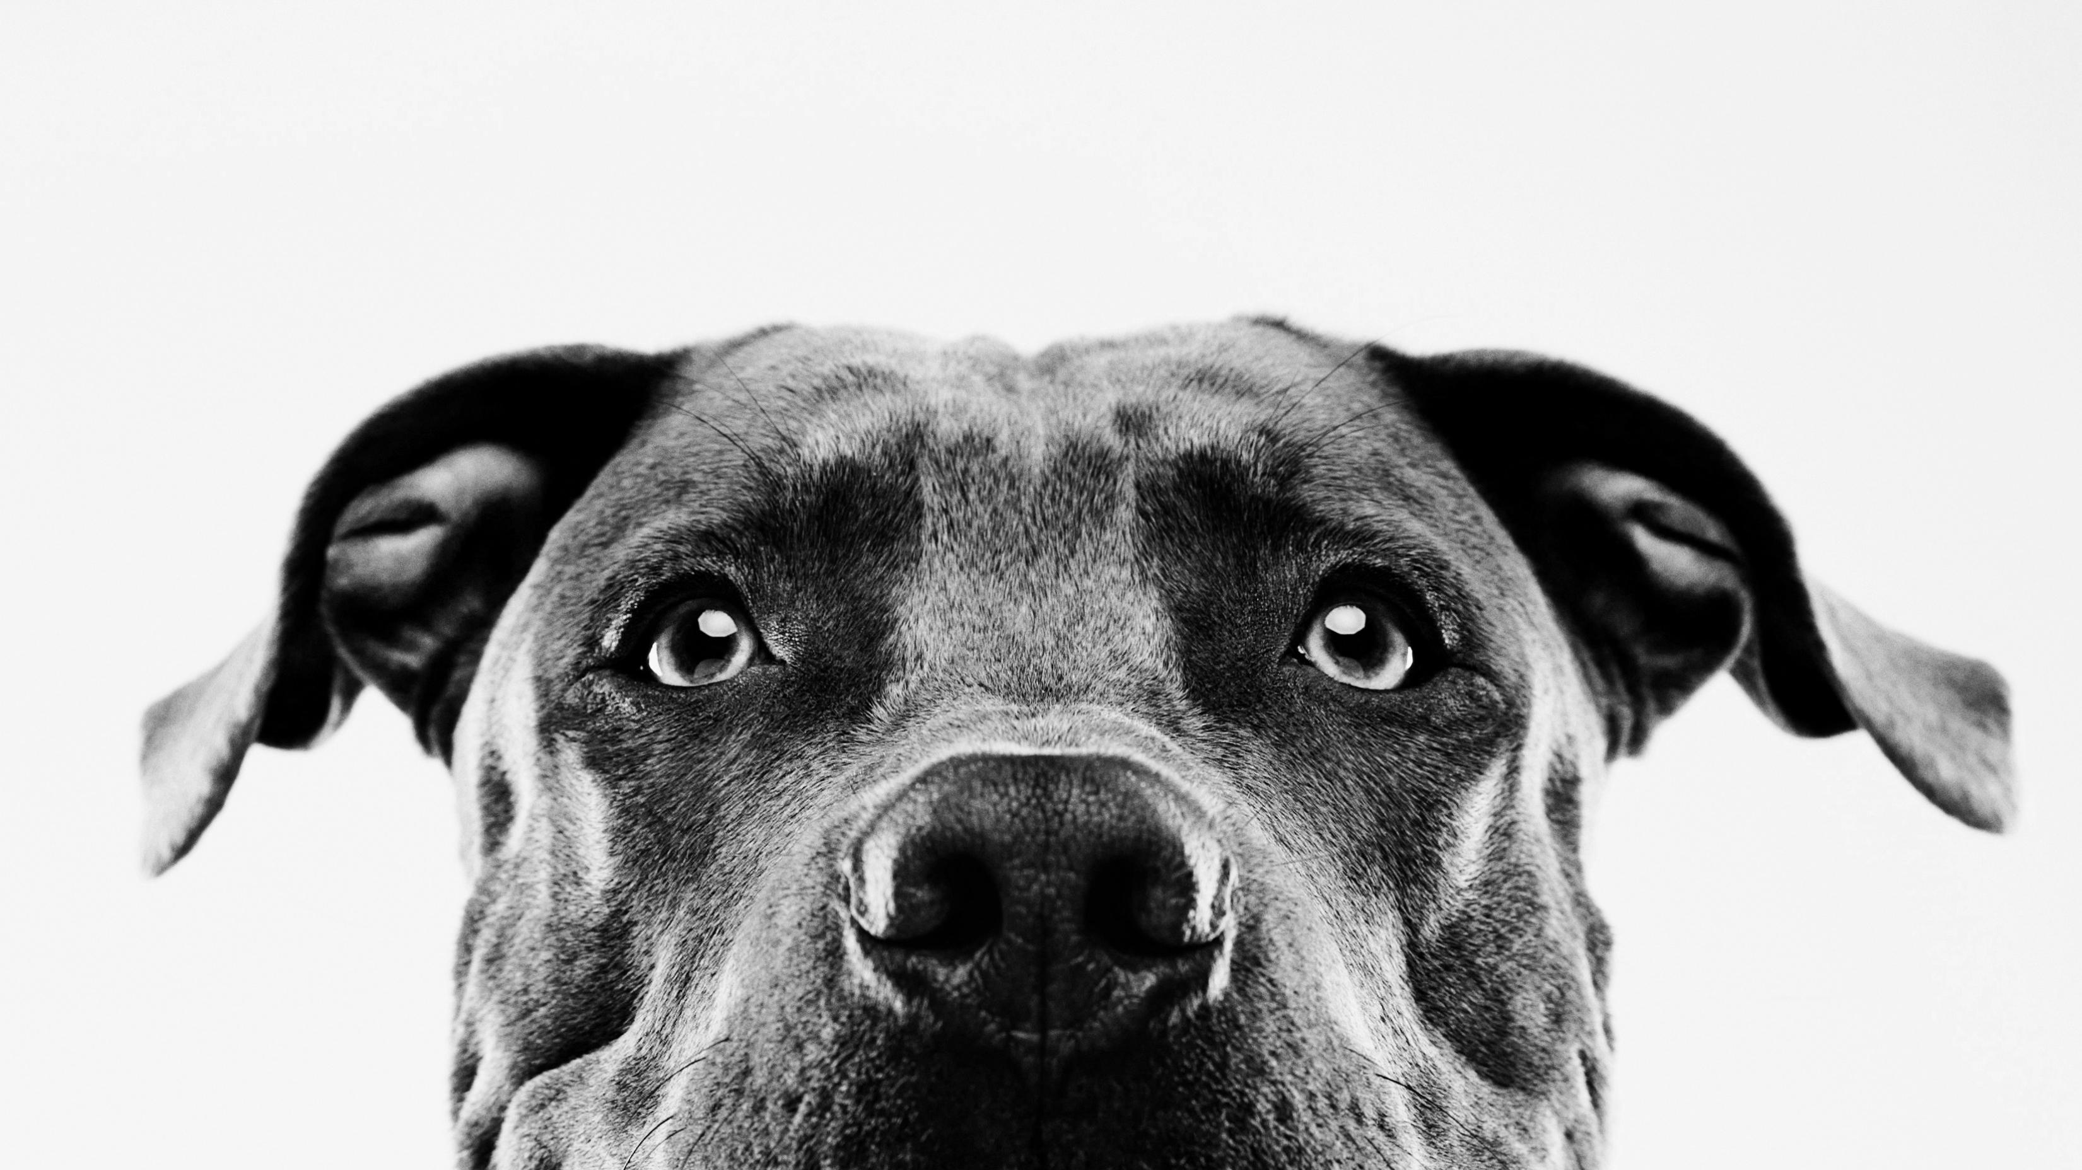
Home schooling poem
By Jamie

Slide 2
Home schooling has been fun,
But now I think my time is done,
After a week my mum has pushed me,
But my maths and English is better than it should be.

Slide 3
I think she deserves some credit,
She has helped me for my benefit,
My dad is at work all the time,
As a key worker is he online?

Slide 4
With cyber criminals,
After our secrets,
Keep safe online,
Otherwise your account will go benign.

Slide 5
My dog gets his morning walk,
As he hears us talk,
He’s so old,
That he’s nearly bald.

Slide 6
My sister on the other hand,
Thinks she’s so cool that she should be fanned,
Following me around the house,
Though she’s as quiet as a mouse.

Slide 7
All I can think about at the moment,
Is a very big doughnut,
We’re kept in the cage,
This has filled me up with rage.

Slide 8
I can’t take this anymore,
It has become such a bore,
Although I’m giggling at my desk,
I’m writing this at my best.

Slide 9
The end
I hope you enjoyed my poem ☺

